Slide 1
C++

Slide 2
Definitions
Abstract Data Types
Design By Contract
UML
Objects
Classes

Slide 3
Definitions
Abstraction – a view that focuses on essential characteristics and relevant information and that ignores implementation details
Abstract Data Type (ADT) – a programmer created data type that specifies the values that that data type can hold and the operations that can be performed, without specifying implementation details
Class – a blueprint for object creation. By separating the method definitions from the class declaration, a class can become an abstract data type.
Object – software entity, instance of a class, that combines data members and functions that act as a single unit.

Slide 4
Definitions
Encapsulation – the bundling of an object’s data and procedures into a single unit; a class encapsulates both data members and functions together in a single unit
Data hiding – restricting access to certain members of an object
Provide a layer of protection against inadvertent or deliberate data corruption by allowing only member functions to directly access and modify an object’s data.
Need-to-know – a programmer can use the data via the provided member functions; the programmer needn’t worry about implementation details.
Notes:
Thus, an object encapsulates the data members (state) and member functions (behavior).

Slide 5
More on Abstraction
Do you have to know specifically how the inner workings of a toaster works before toasting your bread?
Do you have to know what happens under the hood of your car in order to start it?
Do you have to know specifically how cout works (or printf) before using it in a program? Do you care?
How about the C strcpy() function? You just need to know that there are two arguments and in this order: (dest, source)

Slide 6
More on Abstract Data Types
An Abstract Data Type is a type with associated operations, but whose implementation is hidden.
The user of an ADT does not need to know any implementation details (e.g. how the data is stored or how the operations are carried out).
This allows for an implementation (that may be complicated) of a data type to be encapsulated into a simple interface. The user doesn’t need to be bothered with the complexity or the details, just know how to use it.
Objects such as lists, sets, and graphs, along with their operations, can be viewed as ADTs.
Notes:
For example, a list interface can be implemented as a linked list (singly with head and tail pointers or doubly) or as an array. Do you have to know ahead of time specifically how it is implemented to use it? No, you just need to know how to use it: how to declare (several ways); the operations that may be performed: just a push_front() or push_back() (no return value, argument is the value to be pushed); or pop_front() or pop_back() (not return value, no arguments)
Same thing with a stack – it can be implemented with a vector or an array. As a user, I don’t need to worry about how it is implemented. I just have to worry about how to use it. I should expect that a pop does what a pop is supposed to do and a push does what it is supposed to do.

Slide 7
Reasons For Abstract Data Types
Allows for what may be complicated implementations to be hidden from the user.
Generally leads to a flexible design if designed well.
Less coding for the programmer.
Leads to more reusability.
Can generalize a design. When you have many objects that have similar functionalities, you can abstract the common functionalities and have the other objects inherit from it.
Leads to easier maintenance. If an implementation of an ADT requires some modification, none of the code that uses the ADT needs to be touched – only the implementation code of the ADT.
Creates the possibility of polymorphism.

Slide 8
Abstract Data Types
Data abstraction is a programming and design technique that relies on the separation of interface and implementation.
In C++, classes provide a great level of data abstraction. They provide sufficient public methods to the outside world to play with the functionality of the object and to manipulate the object data (state) without actually knowing how the class has been implemented internally.
Notes:
This leads to the concept of Design By Contract

Slide 9
Design By Contract
A software correctness methodology that uses pre-conditions and post-conditions to document the change in state caused by a piece of a program.
Also known as “contract programming”.
It assumes that all client components that invoke an operation will meet the preconditions required (i.e. follow the rules). If the user does in fact meet the preconditions, then the post-conditions are guaranteed.
For example, with getTop() for a stack:
Pre: stack is not empty
Post: the item on the top will be returned
The opposite of this is “defensive programming”.
Notes:
So, the developer of a stack interface needs to abide by the contract, and so does the user. That’s why we have pre- and post- conditions. Pre- conditions have to be satisfied by the caller in order for the provider to guarantee the post- conditions.

Slide 10
Object-Oriented Programming
Rests on 3 basic principles of encapsulation:
Abstraction (ignore the details)
Modularization (break into pieces)
Information hiding (separate the implementation from the interface)
OOP uses classes, which house together data with operations that act on that data.
We strive for loose coupling: each class is largely independent and communicates with other classes via a small well-defined interface.
We strive for cohesion: each class performs one and only one task (for readability and reuse).
We strive for responsibility-driven design: each class should be responsible for its own data. You should ask yourself: What does the class need to know? What does it do?
Notes:
Stack interface can be implemented with a vector or an array – don’t need to know

Slide 11
Object-Oriented Programming
The power of O-O programming also comes from two further principles, which we will discuss later:
Inheritance: classes inherit properties from other classes
Polymorphism: there are multiple implementations of methods and the correct one is executed

Slide 12
Literate Programming
Good programming requires extensive comments and documentation. At the very least, you should:
explain the purpose of each instance variable
and for each method explain its purpose, parameters, returns where applicable.
You should also strive for a consistent layout and for expressive variable names.
For a class, one might list the functions, constructors and public fields; and for each method explain what it does together with pre-conditions, post-conditions, the meaning of parameters, exceptions that may be thrown, and other things.
UML is an extensive language for modeling programs, especially those for O-O programming languages. It is a system of diagrams designed to capture objects, interaction between objects, and organization of objects, and then some.

Slide 13
Testing
One needs to test extensively.
Look at the boundary values: make sure it handles the smallest or largest value the program must work for, and suitably rejects the value just out of range.
Add watches or debug statements so that you know what is happening at all times.
Especially look at the empty case, or the 0 input.

Slide 14
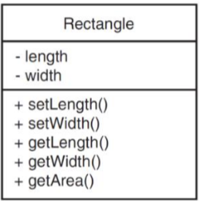
UML (Unified Modeling Language)
Standard diagrams for depicting classes.
Class name, attributes (data members) and methods are specified.
Private members have a prefix of “-” and public members have a prefix of “+”.

Slide 15
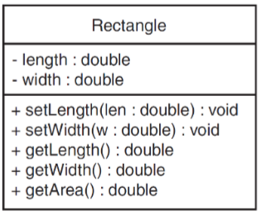
UML (Unified Modeling Language)
If more details are desired, the data types are specified using a colon.
Also, data types of method parameters and return value are specified using a colon.

Slide 16
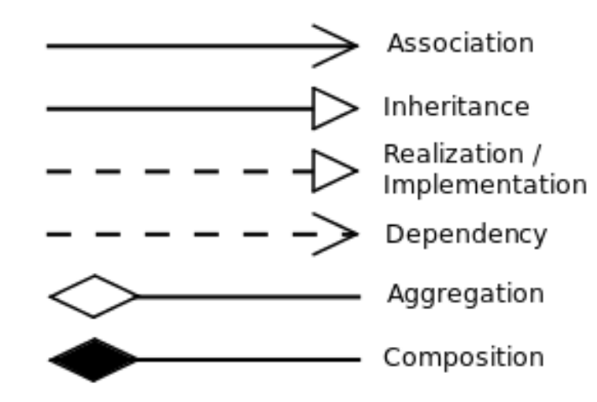
UML
Connections between classes are made with varying types of lines with arrows, triangles, diamonds, etc. depending on their relationship.

Slide 17
Class Example
class Square {
private:
int side;
public:
void setSide( int s );
int getSide( );
int area( );
};
Square
- side : int
+ setSide(s : int) : void + getSide() : int + area() : int
Notes:
Access specifiers:
private – members of the class can be accessed only by other members of the class (data will be private)
- - > if not specified, default is private
public - members of the class are accessible from anywhere an object is visible (methods will be public)

Slide 18
Objects
An object is an instance of a class.
It is defined just like other variables when declared.
Square sq1;
It can access members using dot operator.
sq1.setSide(5);
cout << sq1.getSide();
cout << sq1.area();
class Square {
private:
int side;
public:
void setSide( int s );
int getSide( );
int area( );
};

Slide 19
Objects
Setter functions (mutator): modifies a member variable
void setSide( int s );
Getter functions (accessor): gets, or uses, a value from a member variable int getSide( );
class Square {
private:
int side;
public:
void setSide( int s );
int getSide( );
int area( );
};
Notes:
Conventions: use “get” in the name of getter functions and “set” in the name of the setter functions

Slide 20
Class Example with Inline Functions
class Square {
private:
int side;
public:
void setSide( int s ) { side = s; }
int getSide( ) { return side; }
int area( ) { return side * side; }
};

Slide 21
Class Example without Inline Functions
Prototypes go in class definition.
Implementations go outside the class definition (in a separate file).
void Square::setSide( int s ){
side = s;
}
int Square::getSide( ) {
return side;
}
int Square::area( ) {
return side * side;
}
class Square {
private:
int side;
public:
void setSide( int s );
int getSide( );
int area( );
};
Notes:
Generally we will not use inline functions. When they are used, they are used for really short functions (one line).

Slide 22
Tradeoffs of Inline vs. Regular Member Functions
When a regular function is called, control passes to the called function
the compiler stores return address of call, allocates memory for local variables, etc.
Code for an inline function is copied into the program in place of the call when the program is compiled
Takes longer to compile and makes a larger executable program, but
There is less function call overhead, and possibly faster execution

Slide 23
Constructors
A constructor is a member function that is often used to initialize data members of a class.
Is called automatically when an object of the class is created.
It must be a public member function.
It must be named the same as the class.
It must have no return type, not even void.

Slide 24
Constructors – 2 Examples
class Square {
private:
int side;
public:
Square(int s);
void setSide( int s );
int getSide( );
int area( );
};
Square::Square(int s) {
side = s;
}
class Square {
private:
int side;
public:
Square(int s)
{ side = s; }
void setSide( int s );
int getSide( );
int area( );
};
Notes:
inline vs not inline

Slide 25
Constructors
But, what happens when you define your own constructor?

Slide 26
Constructors
Once you define your own constructor, you lose the default constructor that the compiler previously provided.
You can overload the constructor, including a programmer-defined default constructor; they must have different parameter lists:
Square( ); // default constructor - has no // parameters
Square(int);

Slide 27
Constructors
Constructors cannot be called explicitly as if they were regular member functions. They are only executed when a new object of the class is created (instantiated).
Also, remember that constructors do not have a return value - - not even void.

Slide 28
Constructors
In the class specification below, the Box class includes two constructors:
Box() and Box(int w, int l, int h)
// box.h (specification file)
class Box {
public:
Box();
Box(int w, int l, int h);
~Box();
int volume();
void set_values(int w, int l, int h);
private:
int width;
int length;
int height;
};
int main() {
Box b1;
Box b2(4, 3, 5);
Box *b3 = new Box(5, 7, 2);
b1.set_values(5, 7, 3);
cout << "b1 volume = "
<< b1.volume()
<< endl;
cout << "b2 volume = "
<< b2.volume()
<< endl;
cout << "b3 volume = "
<< b3->volume()
<< endl;
}

Slide 29
Destructors
In the class specification below, the destructor is in blue font.
// box.h (specification file)
class Box {
public:
Box();
Box(int w, int l, int h);
~Box();
int volume();
void set_values(int w, int l, int h);
private:
int width;
int length;
int height;
};
int main() {
Box b1;
Box b2(4, 3, 5);
Box *b3 = new Box(5, 7, 2);
b1.set_values(5, 7, 3);
cout << "b1 volume = "
<< b1.volume()
<< endl;
cout << "b2 volume = "
<< b2.volume()
<< endl;
cout << "b3 volume = "
<< b3->volume()
<< endl;
}
Notes:
If add a comment in the destructor, and then run this program, will see the comment printed twice. It is automatically called for non-pointer types of variables (stack resident variables). You would have to add a line of code to the main to delete b3; in order to explicitly deallocate that memory. But still, no code needs to be added to the destructor itself.

Slide 30
Destructors
The destructor fulfills the opposite functionality as the constructor. It is automatically called when an object is destroyed, either because its scope of existence has finished or because it is an object dynamically assigned and it is released using the operator delete.
The destructor must have the same name as the class but preceded with the tilde sign (~), and it must also return no value.
The use of destructors is especially suitable when an object assigns dynamic memory during its lifetime, and at the moment of being destroyed we want to release the memory that the object had been allocated.
Notes:
Rule of zero:
If you don’t need one, then don’t include one. C++ will optimize the default one provided and it will be more efficient than any user defined destructor.

